Slide 1
Roman Civilization BFA I Section: C,D Class teacher: Aasma Abdul Majeed Visual Arts, LCWU

Slide 2
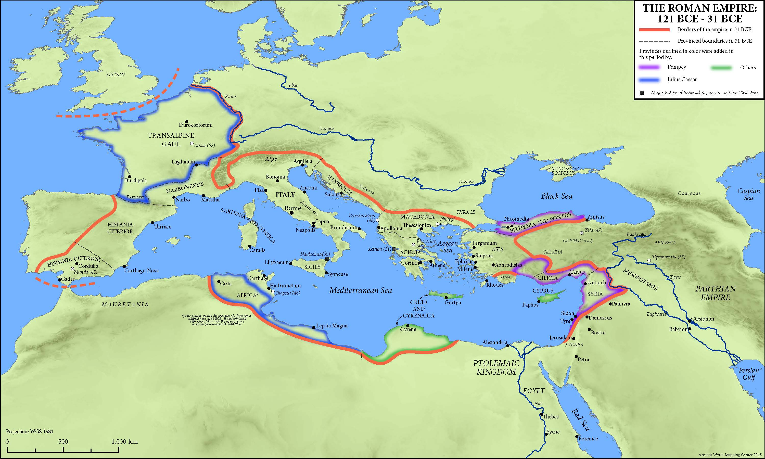
Map of Roman Civilization

Slide 3
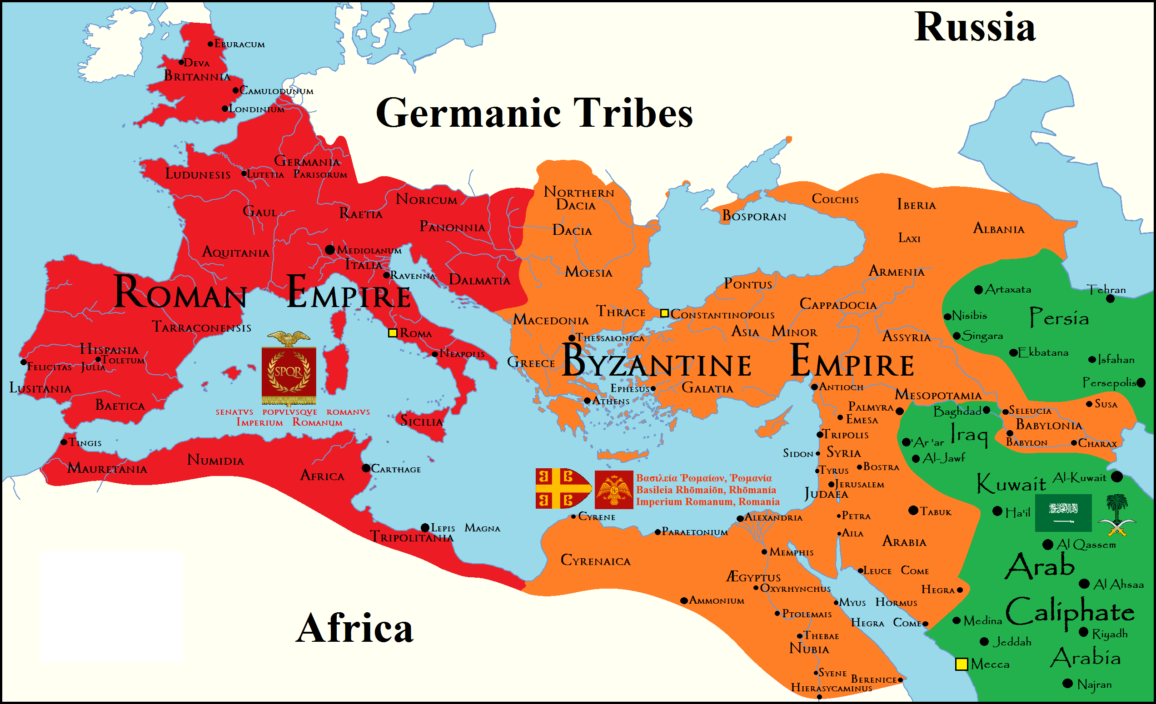

Slide 4
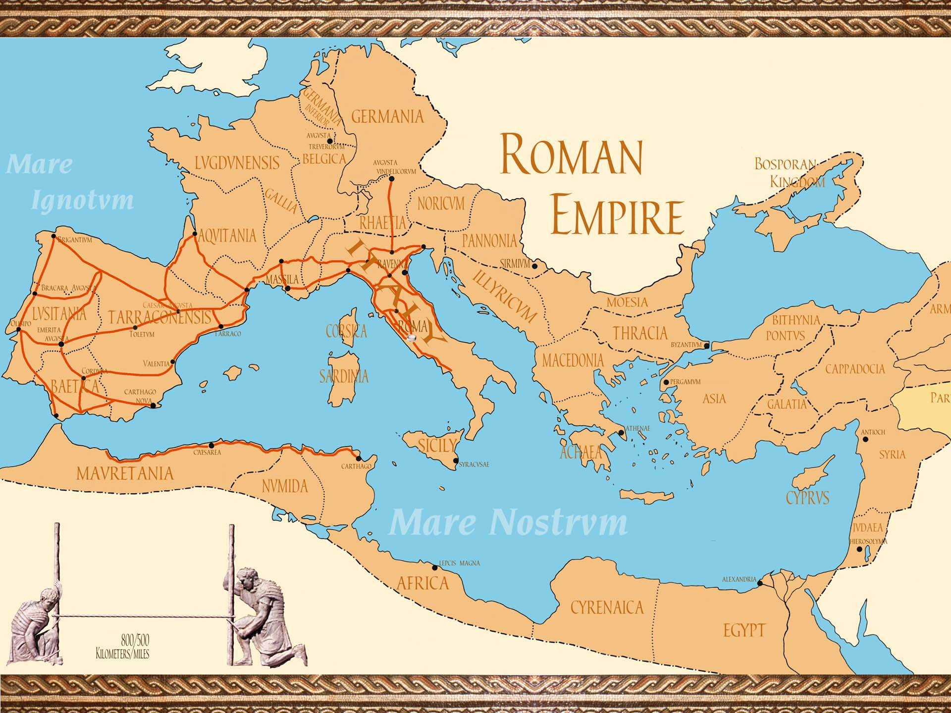

Slide 5
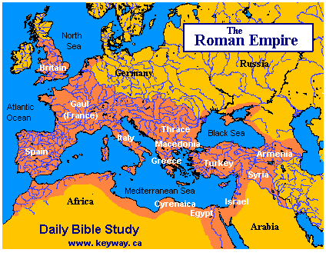

Slide 6
Grandeur of the Roman Civilization
There is a famous phrase that ‘Rome was not built in a day’ , meaning; Important work takes time.
This expression functions as an injunction or plea for someone to be patient. For example,
You can't expect her to finish this project in the time allotted; Rome wasn't built in a day.
This phrase was a French proverb in the late 1100s but was not recorded in English until 1545.

Slide 7
History of the Roman Civilization
Approximately in the 5th Century BC when Buddha was preaching in the Sub-Continent and when in the 3rd Century BC, Ashoka was ruling the Mauryan Empire in the Sub-Continent, another Great Empire was growing in Europe
This Great Empire can further be traced back to the 8th Century BC
It rose from a collection of villages around the seven hills beside the banks of the River Tiber in Italy.
It later grew into a city called Rome
The surrounding countryside was fertile, which very soon made the citizens prosperous
This prosperity helped them in expanding their army, which led them to dominate the entire Italian Peninsula

Slide 8
Making of the Roman Civilization
Once the Italian Peninsula was under their control, they became more stronger
First after a succession of three wars won the area of Carthage and became the strongest power in the Mediterranean by the end of the 3rd Century BC
They also subdued the Greeks who were towards their east and added Macedon and Thrace to their lands
Further they expanded to include, northern Italy, Spain, France, England, North Africa, Asia Minor, Syria, and Palestine

Slide 9
Strengths of the Roman Civilization
It was a huge Empire
Factors that helped in keeping it united
It was guarded well by the army of ‘Legionaries’, who were tough, trained, disciplined and well armed
After giving services for 20 years, they were given lands to farm
Another factor was the building of roads across the length and breadth of the Empire

Slide 10
Timeline of the Roman Civilization
Roman Kingdom ---- 753-509 BCE
Roman Republic ---- 509- 31 BCE
Roman Empire ---- 31-1453 BCE

Slide 11
Roman Painting
We do not find many examples of painting in history except from Ancient Egypt and few from Etruscan’s Tomb and other burial places (meant to decorate).
The painting from Etruscans civilization shows us some Greek traditions, as subjects in funeral rituals, religious ceremonies and athletic competition.
The history of Roman painting is essentially the history of wall paintings on plaster
Although ancient literary references inform us of Roman paintings on wood, ivory, and other materials, works that have survived are in the durable medium of fresco that was used to adorn the interiors of private homes in Roman cities and in the countryside.

Slide 12
Romans borrowed this style of painting in following kinds.
a) Mosaics
b) Fresco
The subject of these paintings was mostly Greek mythology, that was usually composed in landscape.
The technique of fresco painting was very suitable to decorate big walls of houses, as Romans were well to do that that is why they constructed spacious houses for themselves.
Doors and windows were less in number in their houses. That is why they had big empty walls to paint.

Slide 13
Most of their paintings have been found on the walls of their palaces in the city of HERCULANIUM and POMPIE.
These two cities got completely destroyed and buried under heavy Volcanic ash
This played a role in preserving these paintings
These paintings were excavated in the 1st century A.D. in excellent condition.
They show brilliant colours and lustrous quality of painting.

Slide 14
According to Pliny, it was Studius "who first instituted that most delightful technique of painting walls with representations of villas, porticos and landscape gardens, woods, groves, hills, pools, channels, rivers, and coastlines."
Despite the lack of physical evidence, we can assume that many portable paintings depicted subjects similar to those found on the painted walls in Roman villas
It is also reasonable to suppose that Roman panel paintings, which included both original creations and adaptations of renowned Hellenistic works, were the prototypes for the myths depicted in fresco.
Roman artists specializing in fresco most likely traveled with copybooks that reproduced popular paintings, as well as decorative patterns.

Slide 15
Four Different Styles of Painting
Art historians and archaeologists describe the development of Roman painting in four styles.
The First Style (200–60 B.C.) was largely an exploration of simulating marble of various colors and types on painted plaster.
Artists of the Late Republican period (second to first century B.C.) drew upon examples of early Hellenistic (late fourth to third century B.C.) painting and architecture in order to simulate masonry.
Typically, the wall was divided into three horizontal, painted zones crowned with a stucco cornice of dentils based upon the Doric architectural order.

Slide 16
The decline of the First Style coincided with the Roman colonization of Pompeii in 80 B.C., which transformed what had essentially been an Italic town with Greek influences into a Roman city.
Going beyond the simple representation of costlier building materials, artists began to borrow from the figural repertoire of Hellenistic wall painting, depicting gods, mortals, and heroes in various contexts.

Slide 17
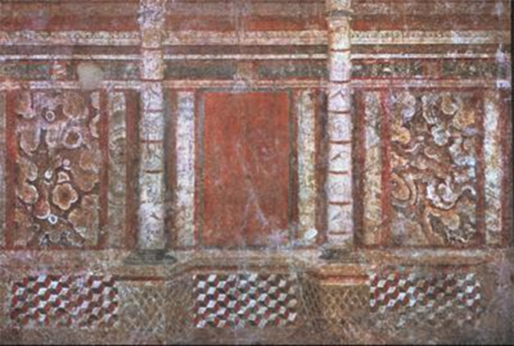

Slide 18
The Second Style in Roman wall painting emerged in the early first century B.C., during which time fresco artists imitated architectural forms purely by pictorial means.
In place of stucco architectural details, they used flat plaster on which projection and recession were suggested entirely by shading and perspective
As the style progressed, forms grew more complex.
The Villa P. Fannius Synistor at Boscoreale is an exceptional example of the fully mature Second Style
Throughout the villa there are visual ambiguities to tease the eye, painted masonry, pillars, and columns that cast shadows into the viewer's space, and more conventional trompe l'oeil devices.
Objects of daily life are depicted in such a way as to seem real, with metal and glass vases on shelves, and tables appearing to project out from the wall.

Slide 19
At Boscoreale, the walls dissolve into elaborate displays of illusionist architecture and realms of fantasy.
Some of the frescoes provide copies of lost, but presumably once famous, Hellenistic paintings.
These wall paintings create the illusion of a three dimensional space from what is actually a two dimensional space. The style opens the wall by portraying windows and porticos (which are essentially roofs supported by columns, almost like a porch) which guide the viewer’s eye towards imaginary scenes that were usually framed by painted columns and other architectural elements.
The intention of the owner was to create a kind of picture gallery, with the choice of subjects most likely based on the quality and renown of the original paintings.

Slide 20
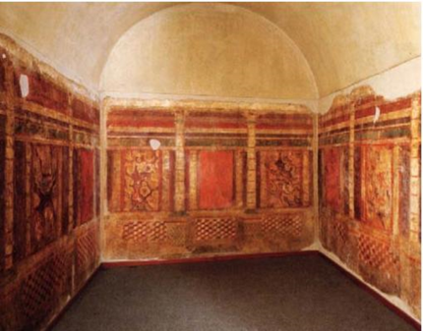
Bedroom of Villa
This painting shows a complicated architectural setting of roof,
stairs and balconies.

Slide 21
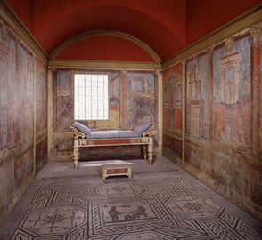

Slide 22
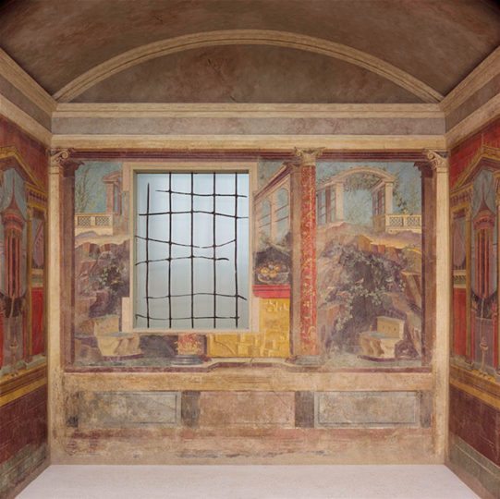

Slide 23
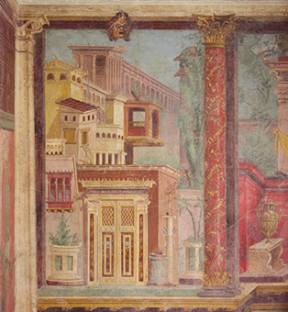

Slide 24
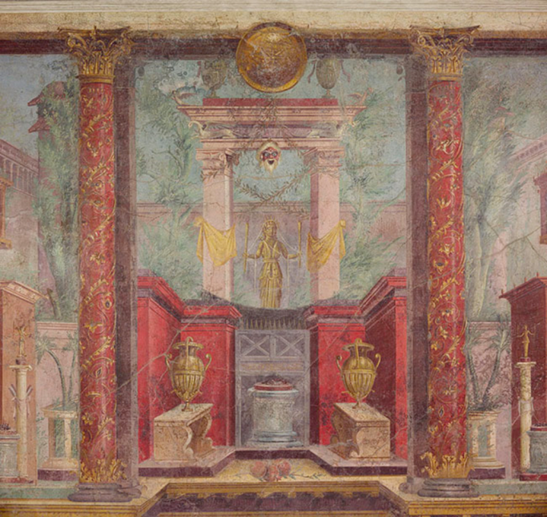

Slide 25
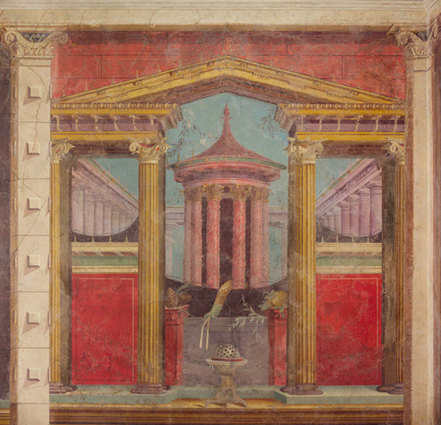

Slide 26
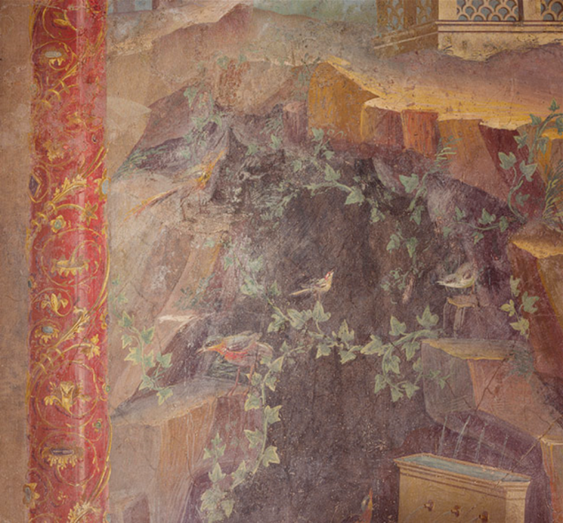

Slide 27
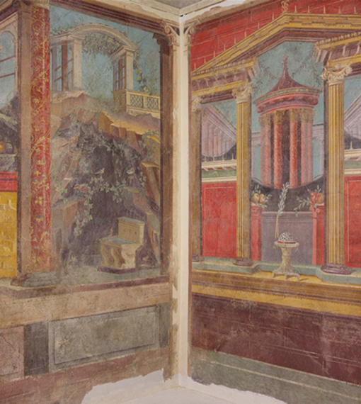

Slide 28
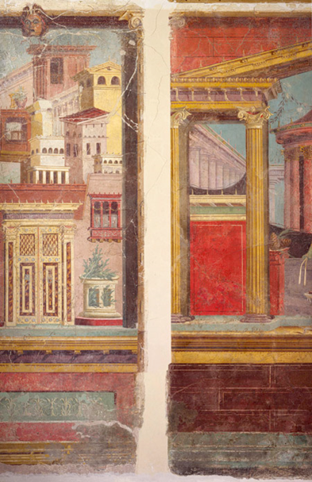

Slide 29
Under Emperor Augustus (27 B.C.–14 A.D.) in the second half of the first century B.C., there was a new impulse to innovate, rather than re-create, in architecture, sculpture, and painting.
The Third Style (20 B.C.– 20 A.D.), which coincided with Augustus' reign, rejected illusion in favor of surface ornamentation.
Wall paintings from this period typically comprise a single monochrome background—such as red, black, or white—with elaborate architectural and vegetal details.
Small figural and landscape scenes appear in the center of the wall as a part of, not the dominant element in, the overall decorative scheme.
The finest known achievements of the early Third Style are the frescoes from the Imperial villa at Boscotrecase
The early Third Style, which was in effect the court style of Emperor Augustus and his friend Agrippa, eventually gave way to a rekindled interest in elaboration for its own sake

Slide 30
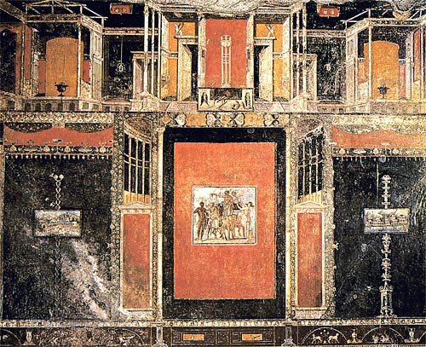

Slide 31
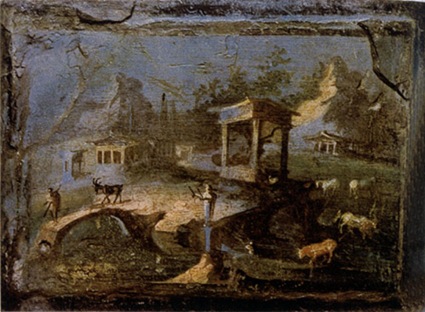

Slide 32
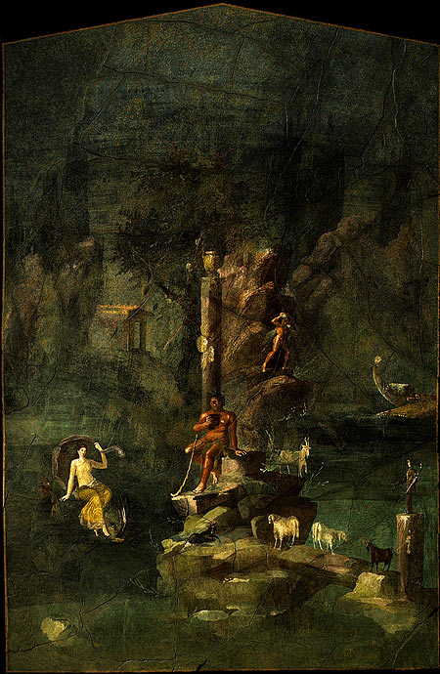

Slide 33
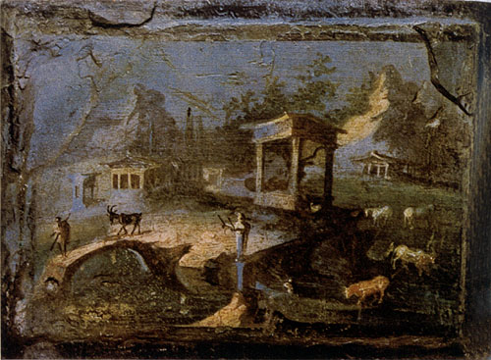

Slide 34
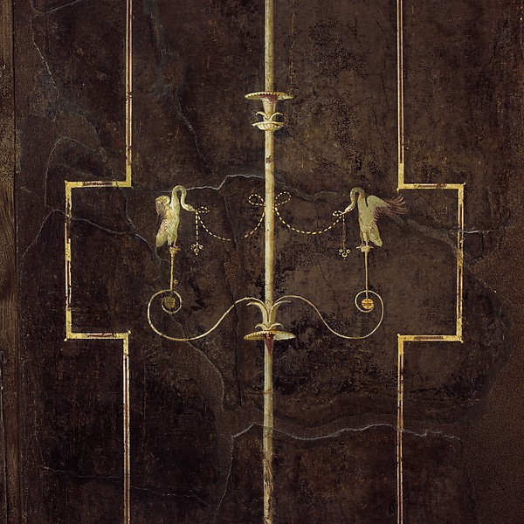

Slide 35
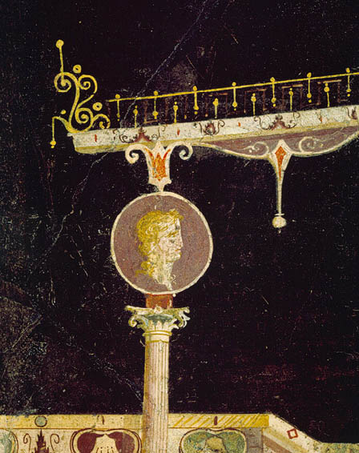

Slide 36
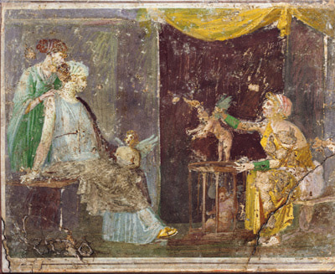

Slide 37
Characterized as a baroque reaction to the Third Style's mannerism, the Fourth Style in Roman wall painting (20–79) is generally less disciplined than its predecessor.
It revives large-scale narrative painting and panoramic vistas, while retaining the architectural details of the Third Style.
In the Julio-Claudian phase (20–54), a textile like quality dominates and tendrils seem to connect all the elements on the wall.
The colors warm up once again, and they are used to advantage in the depiction of scenes drawn from mythology

Slide 38
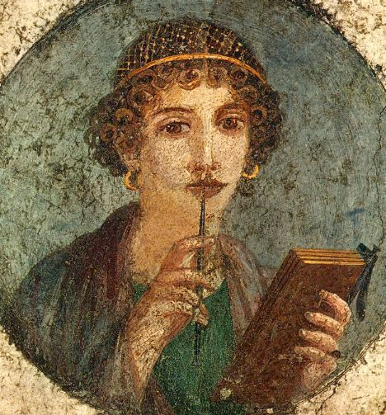

Slide 39
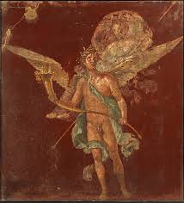

Slide 40
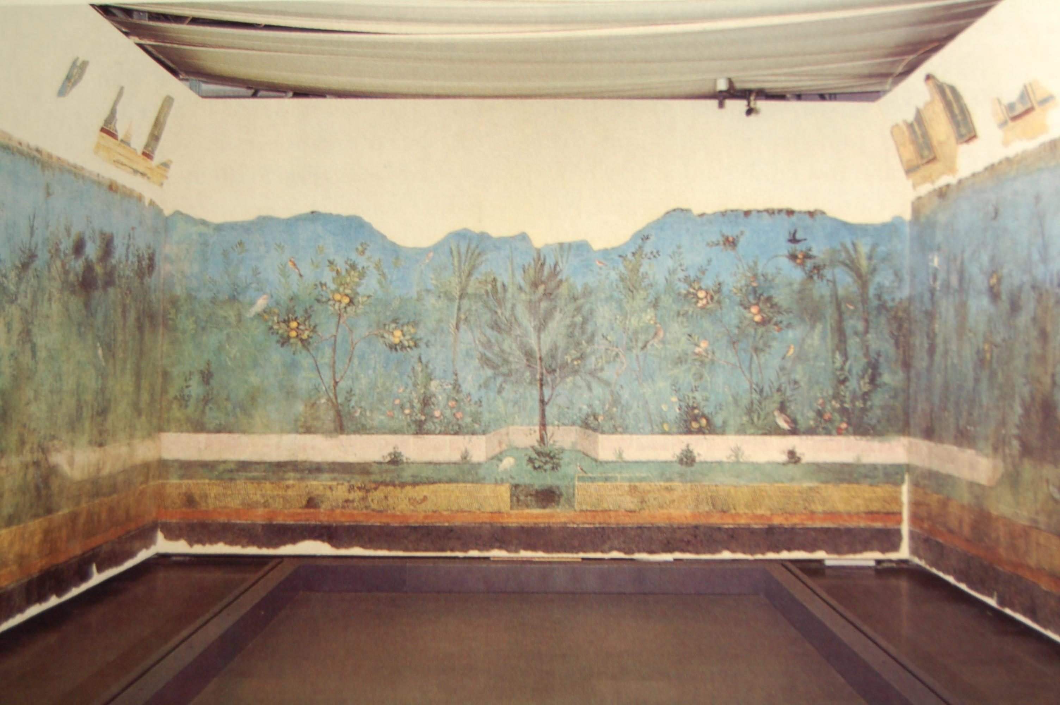

Slide 41
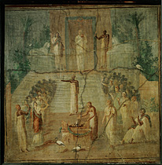

Slide 42
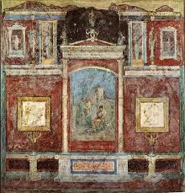

Slide 44
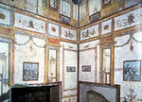

Slide 45
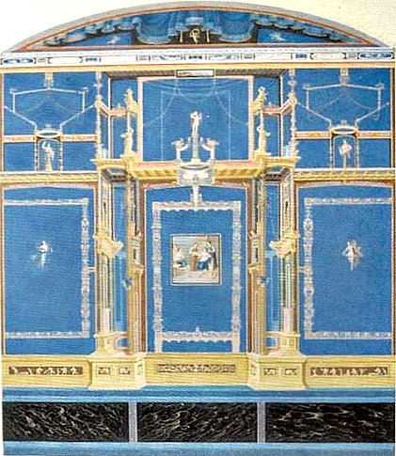

Slide 46
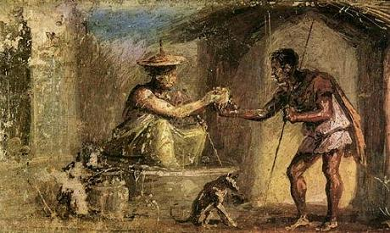

Slide 47
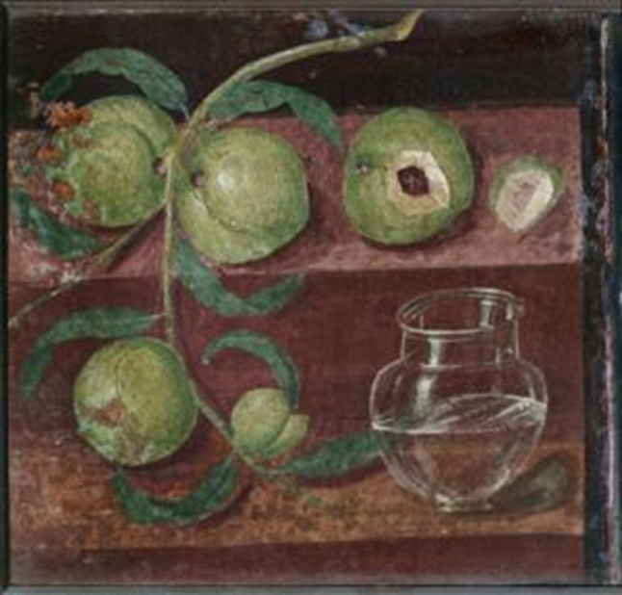

Slide 48
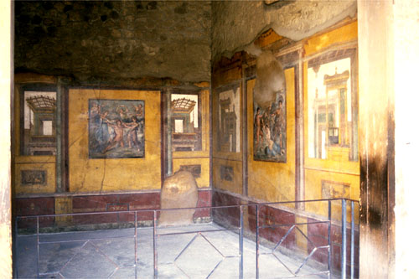

Slide 49
Roman Architecture
Characteristics of Roman Architecture
Romans were great constructors and by the invention of concrete, were able to erect public buildings of enormous size like thermae and basilicas, (gymnasium and courts)
Plan
Plans conveys the impression of vastness and magnificence, the characteristic of powerful and energetic race
Arch
The arch and dome were the key notes
The arch made it possible to span wide openings, vaults and domes. The system of using true arch was followed by Etruscans

Slide 50
Walls
The roman revolutionized by the use of concrete.
The walls were very thick and their outside was covered with bricks, stone, stucco and was decorated with marble, alabaster, from inside attached to the wall.
Openings
Colonnades and new system of arcade were both in use interior and exterior as in colosseum, a circular building with rows of seats, round and open, used for public games and shows.
Door ways
Doorways were both square and semi- circular headed, became decorative feature of importance in large public buildings as in PANTHEON temple at Rome

Slide 51
Windows
Windows generally semi- circular headed were frequently divided vertically by two mullion (upright division between window)
Roofs
With vaults and domes great space could be covered without intermediate sport.
Roof covers were of terracotta, tiles of marble or of bronze.
Flat roofs were used in Thermae (public baths).
Columns
These were the chief decorative motive in roman architecture other their structural importance.
They add pedestals to give height to the columns.

Slide 52
Mouldings
They frequently used mouldings of sculptures on their architecture with refine details.
Ornamentation
In spite of Greek architecture Romans were more concerned with ornamentation in their architecture, both in exterior and interior.
They decorated their buildings with mosaics, frescoes, relief panels applied on walls, vaults, floors.
The marble cement was very frequently used and applied to cover walls and columns on which paintings could be made

Slide 53
Roman architecture was not so original because it was a combination of Greek and Etruscan.
They adopted the column and beam (trabeated style) from Greek and (Arc late system (arch, vaults, dome) from Etruscans.
The marble had been a chief material, throughout in Roman architecture.
Various colours of marble and alabaster was used for decoration
They also used concrete with bricks and stone casing from 1st century A.D. they used prisoners, slaves and some time soldiers for construction.
The dome (cupola) was used on the circular structure like PANTHEON temple.
Semi domes were used for recesses and niches
Rome was the only ancient civilization to develop monumental, secular architecture as well as large scale civil engineering projects, paved roads, bridges, aqua ducts, tunnels, canals and underground drains.

Slide 54
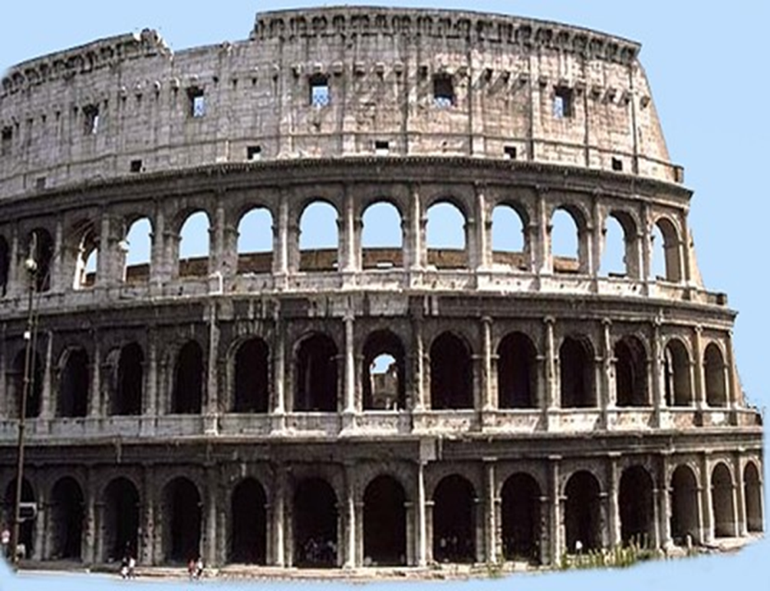
Colosseum

Slide 55
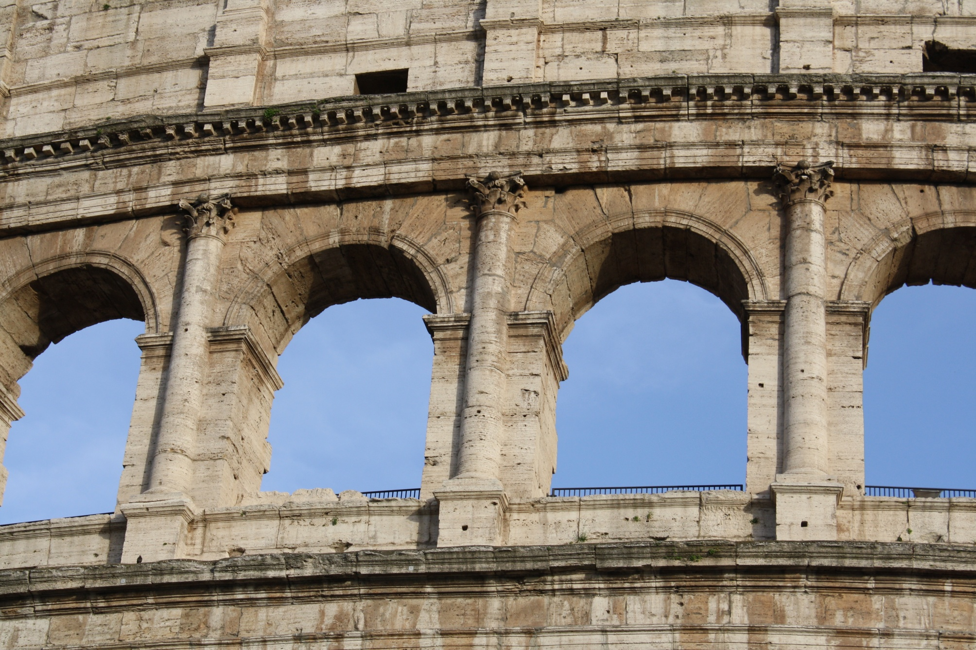
Roman architecture continued the legacy left by the earlier architects
of the Greek world, and the Roman respect for this tradition
is pretty evident

Slide 56
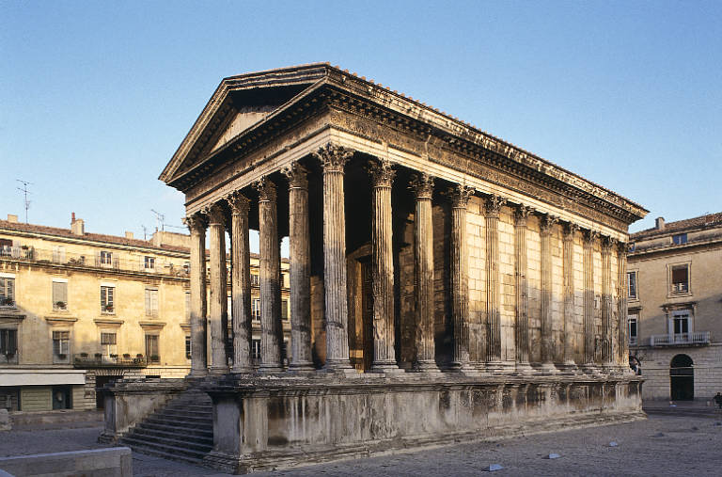
Parthenon

Slide 57
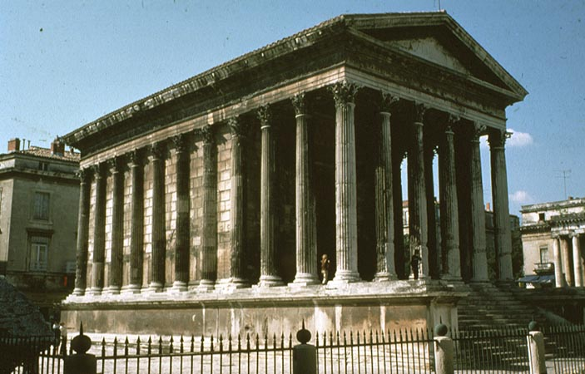

Slide 58
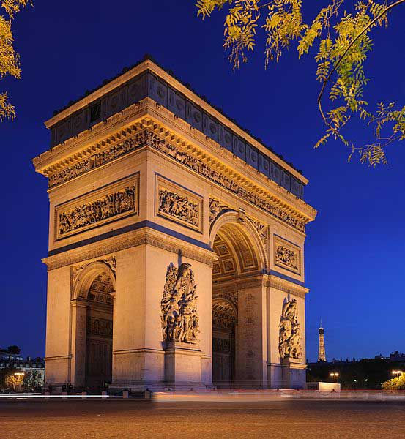
Arch

Slide 59
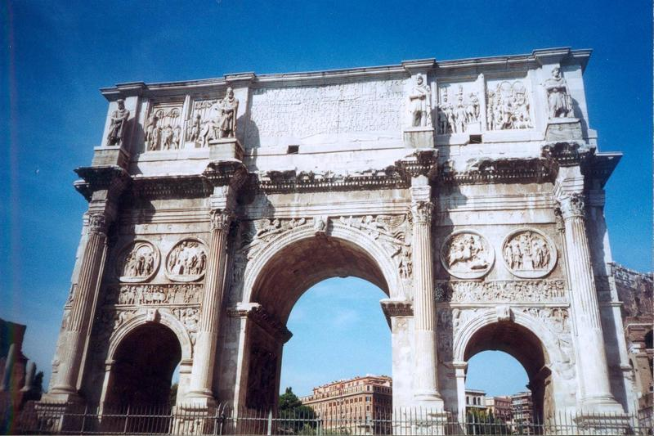
Arch

Slide 60
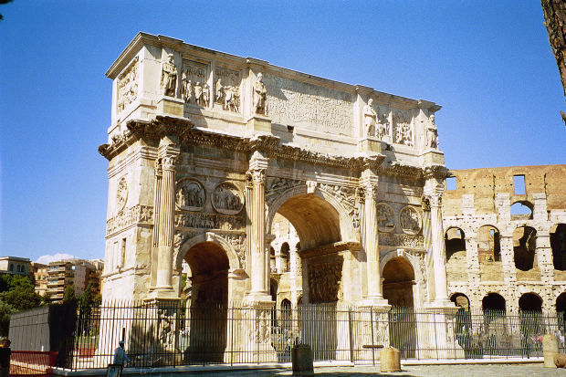

Slide 61
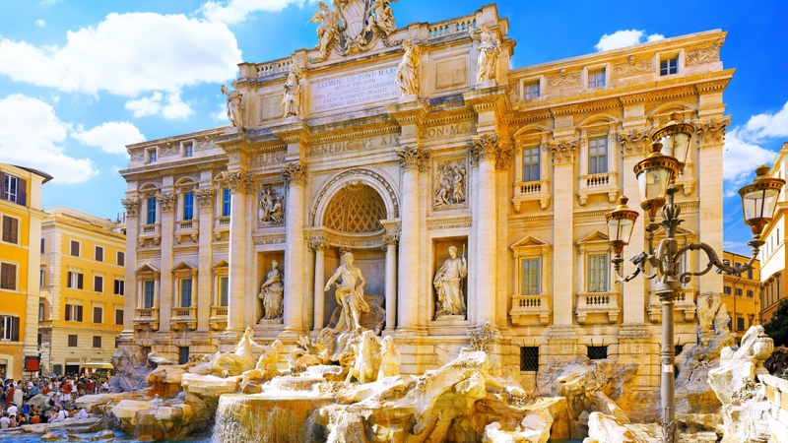
The Coliseum is the Roman amphitheatre built during the first century.
It still exists in the world as a great work of Roman architects.

Slide 62
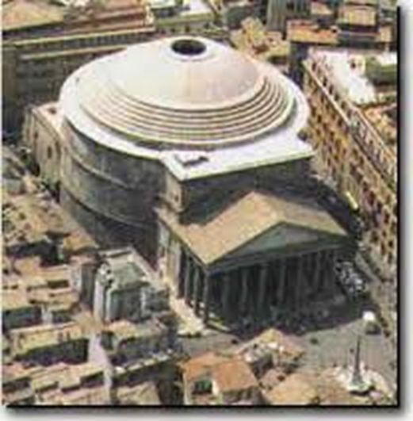
PANTHEON Temple

Slide 63
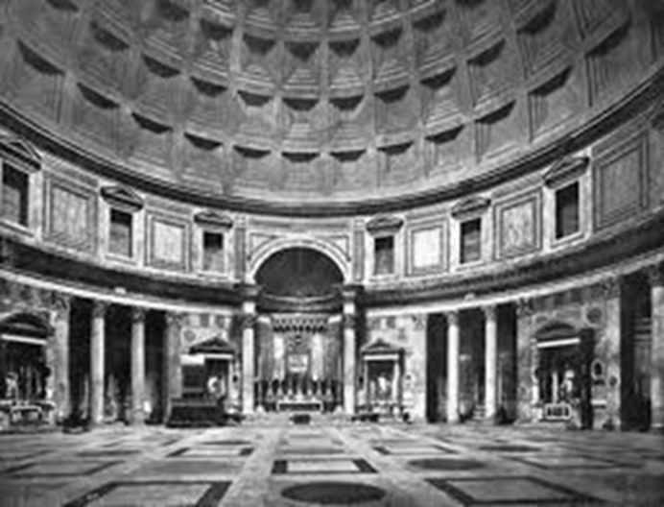

Slide 64
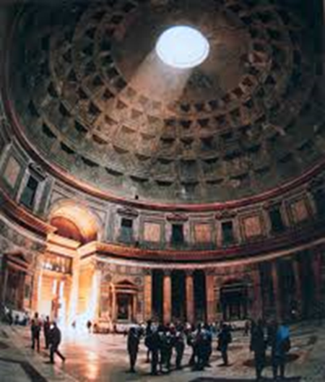
Pantheon temple at Rome is a temple in the CIRCULAR STYLE. It is known to belong to two periods. The circular portion was built by the emperor HADRIAN in 124 A.D. In front of it facing south are 10 columns

Slide 65
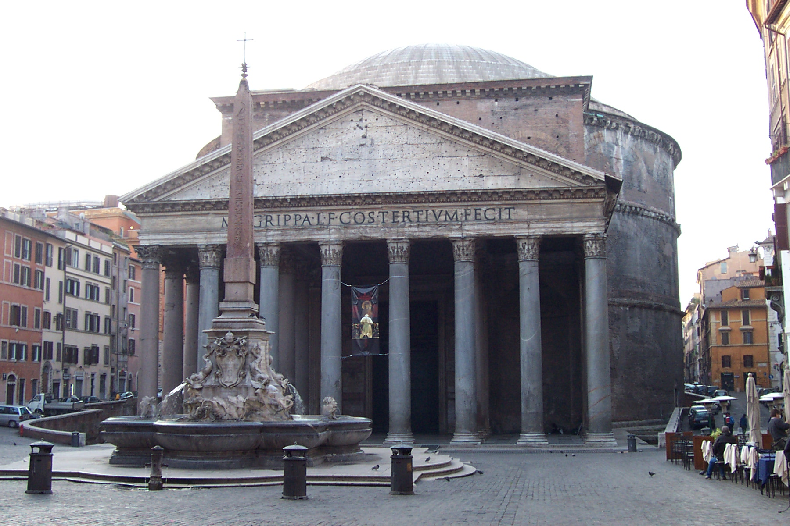
The Romans built it 1800 years ago and it still has the largest dome
made of unreinforced concrete in the world

